Slide 1
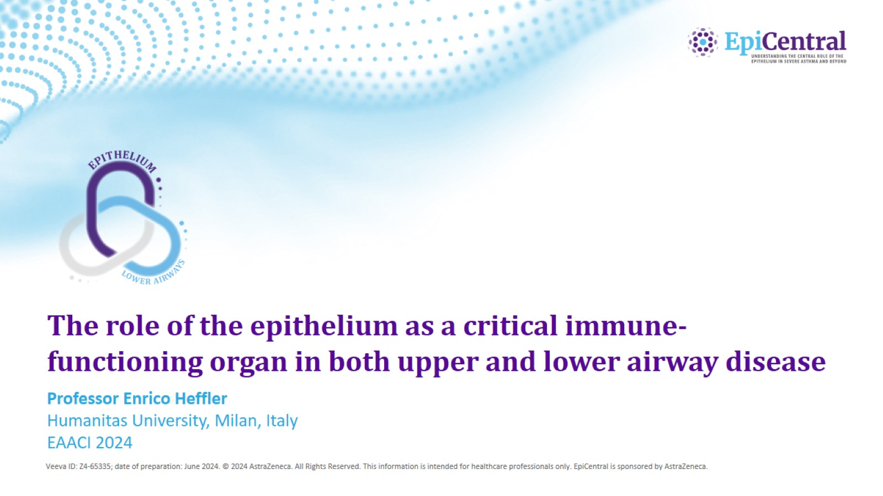
The role of the epithelium as a critical immune-functioning organ in both upper and lower airway disease

Slide 2
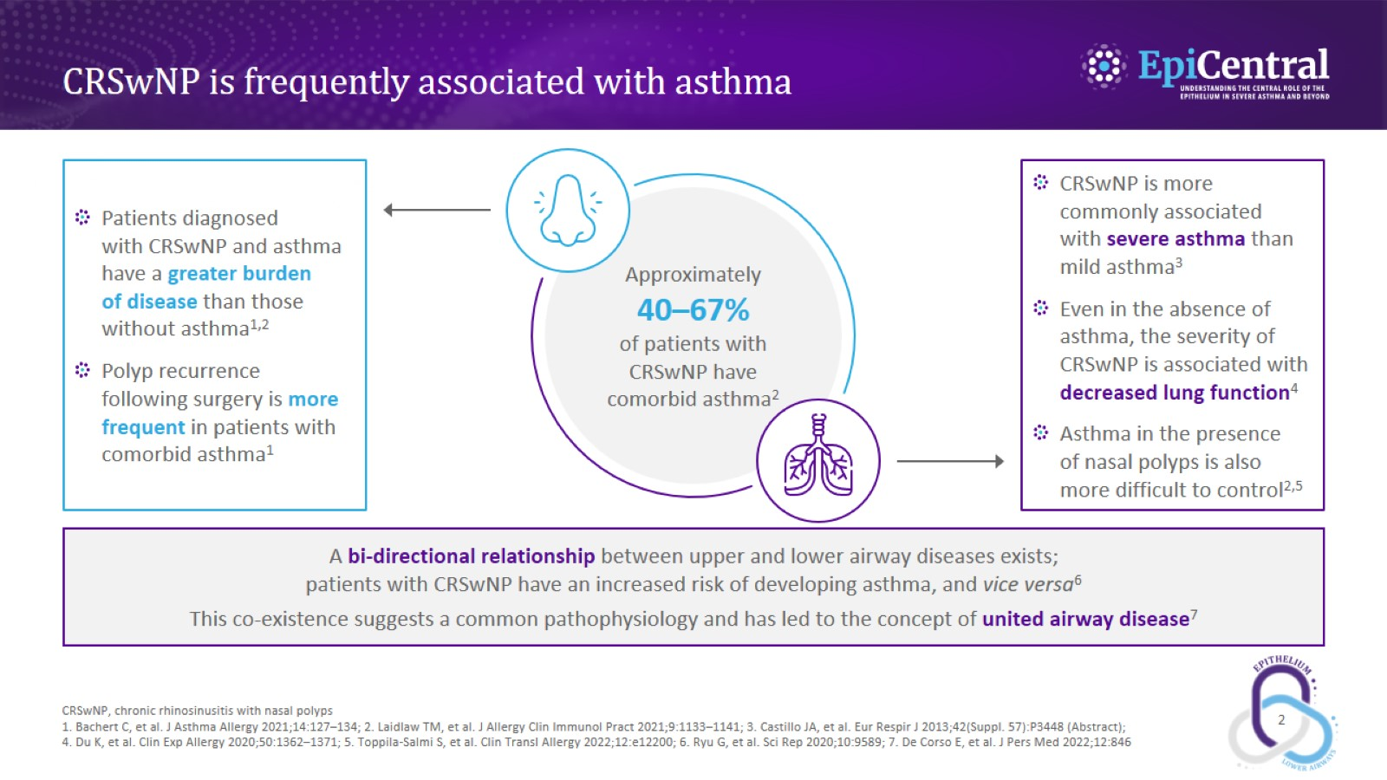
CRSwNP is frequently associated with asthma

Slide 3
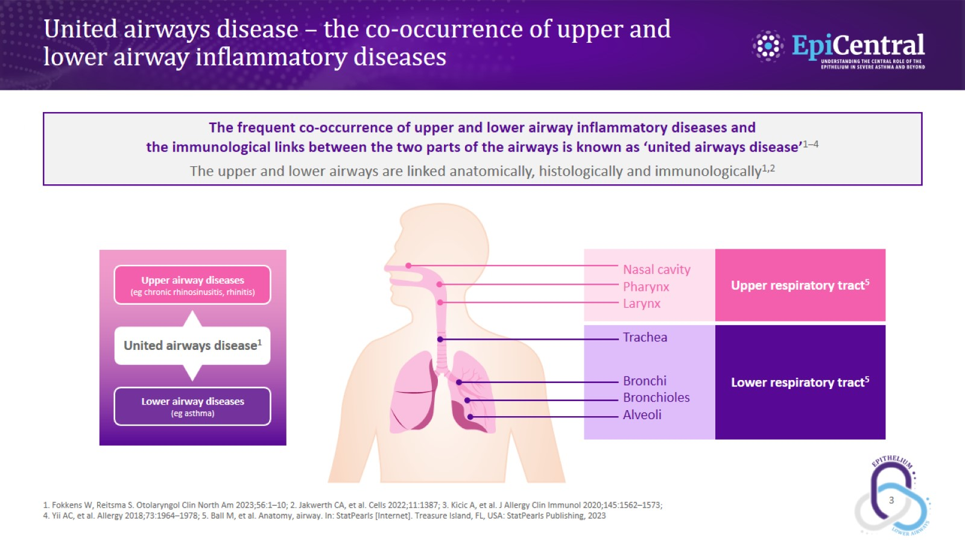
United airways disease – the co-occurrence of upper and lower airway inflammatory diseases

Slide 4
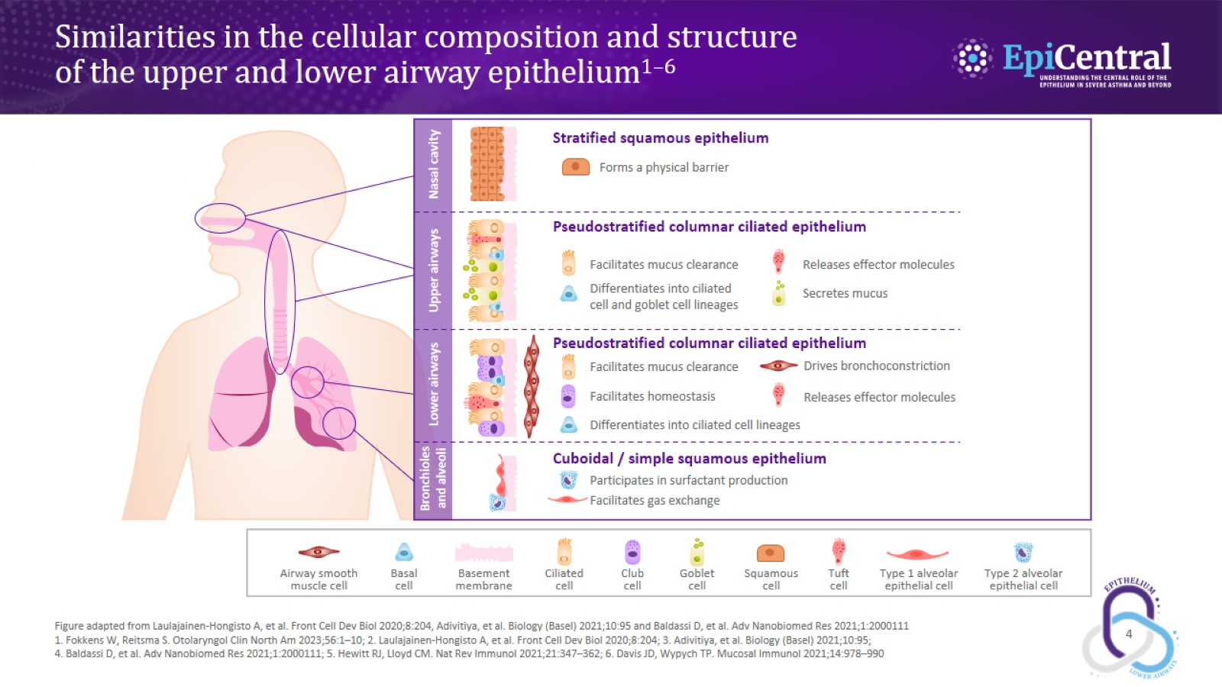
Similarities in the cellular composition and structure of the upper and lower airway epithelium^{1–6}

Slide 5
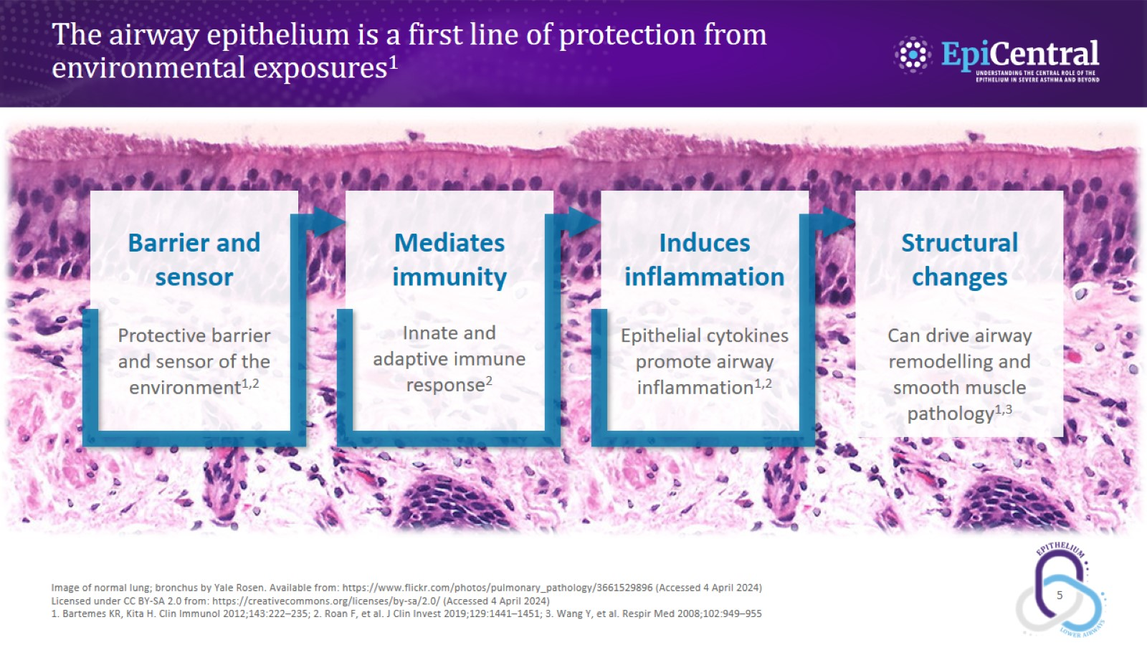
The airway epithelium is a first line of protection from environmental exposures¹

Slide 6
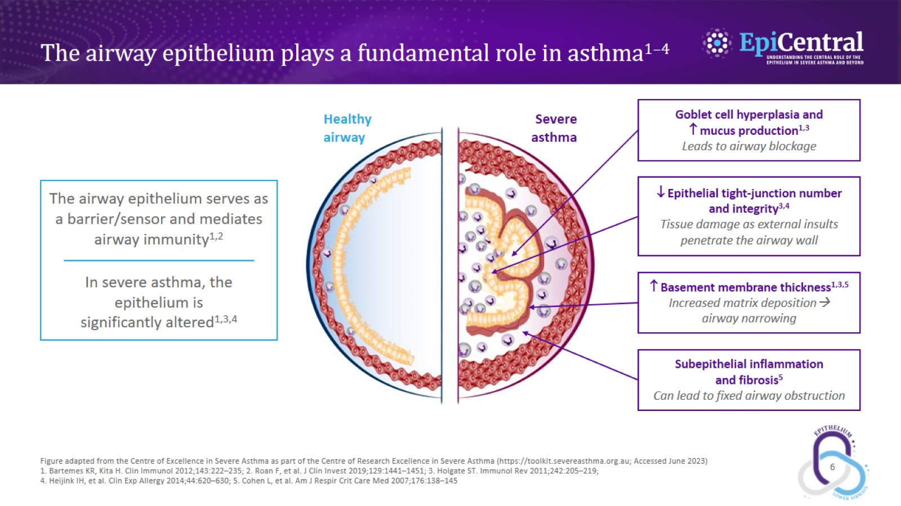
The airway epithelium plays a fundamental role in asthma^{1–4}

Slide 7
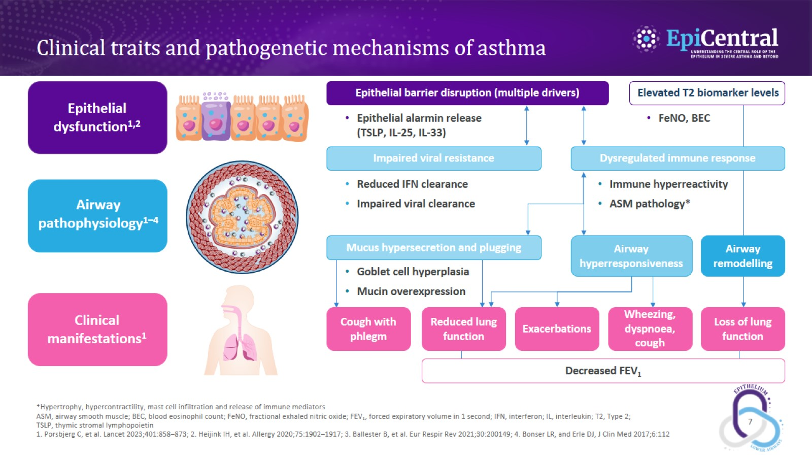
Clinical traits and pathogenetic mechanisms of asthma

Slide 8
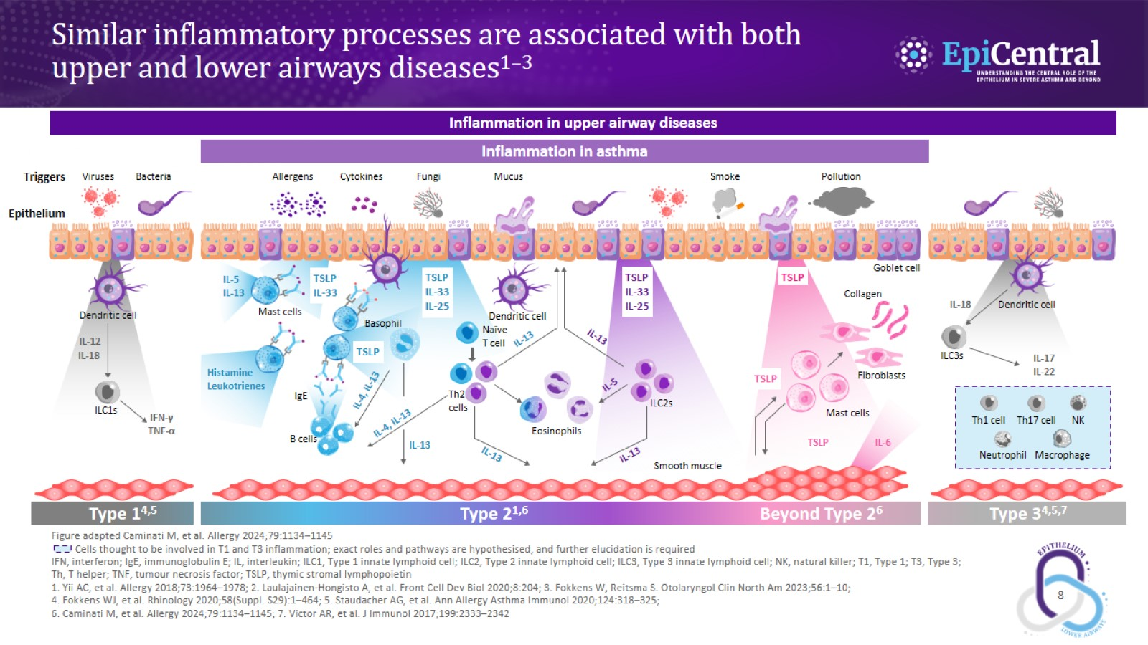
Similar inflammatory processes are associated with both upper and lower airways diseases^{1–3}

Slide 9
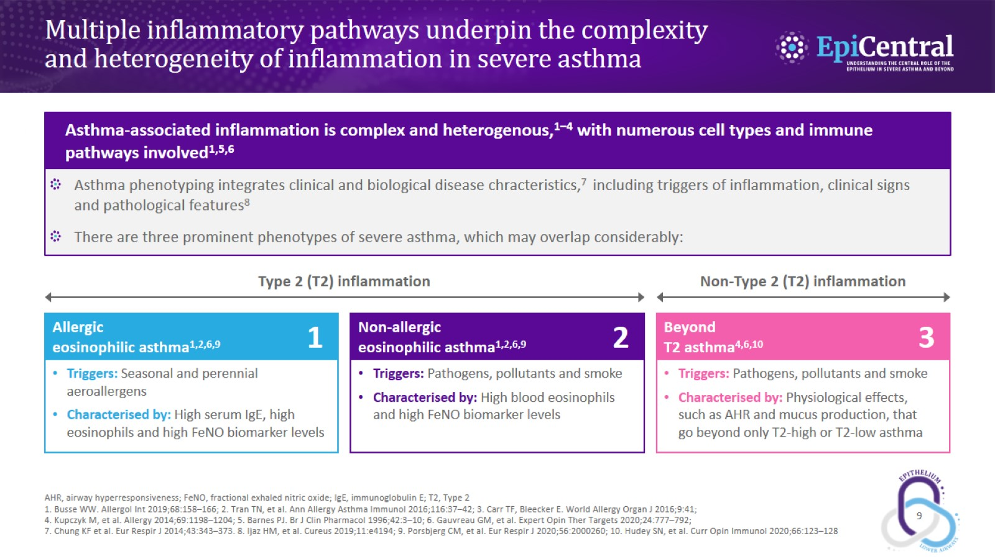
Multiple inflammatory pathways underpin the complexity and heterogeneity of inflammation in severe asthma

Slide 10
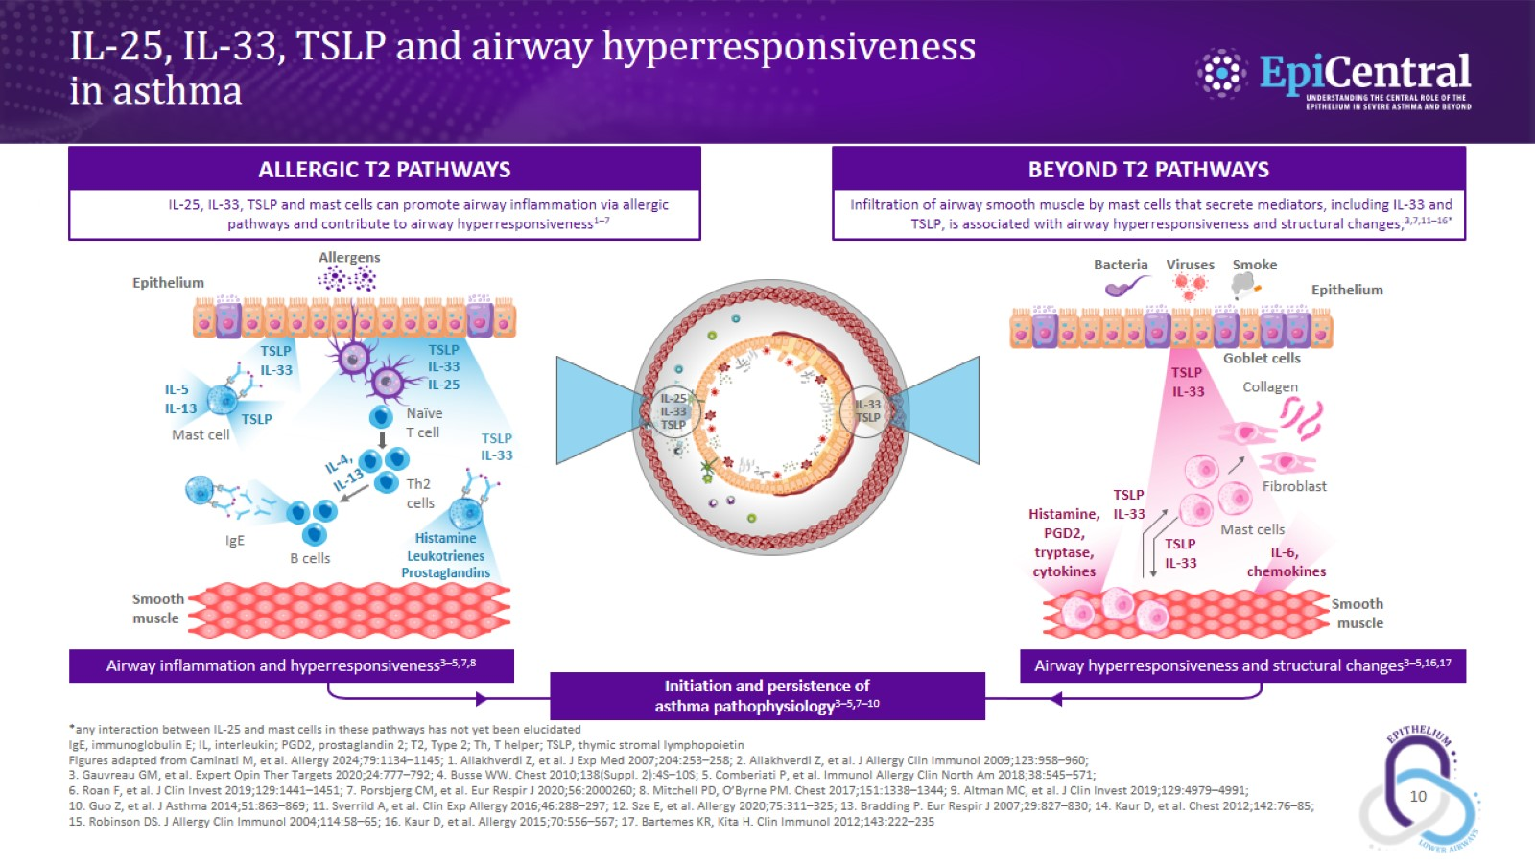
IL-25, IL-33, TSLP and airway hyperresponsiveness in asthma

Slide 11
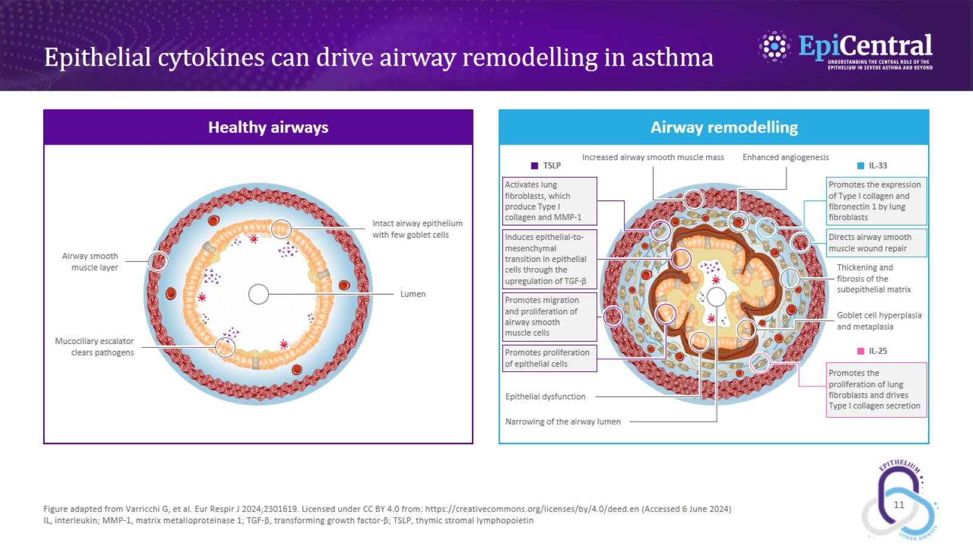
Epithelial cytokines can drive airway remodelling in asthma

Slide 12
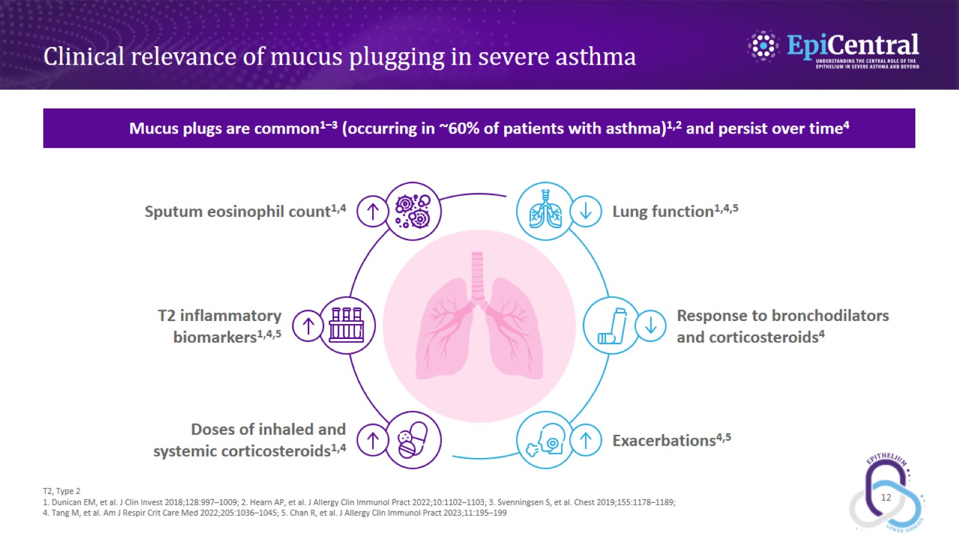
Clinical relevance of mucus plugging in severe asthma

Slide 13
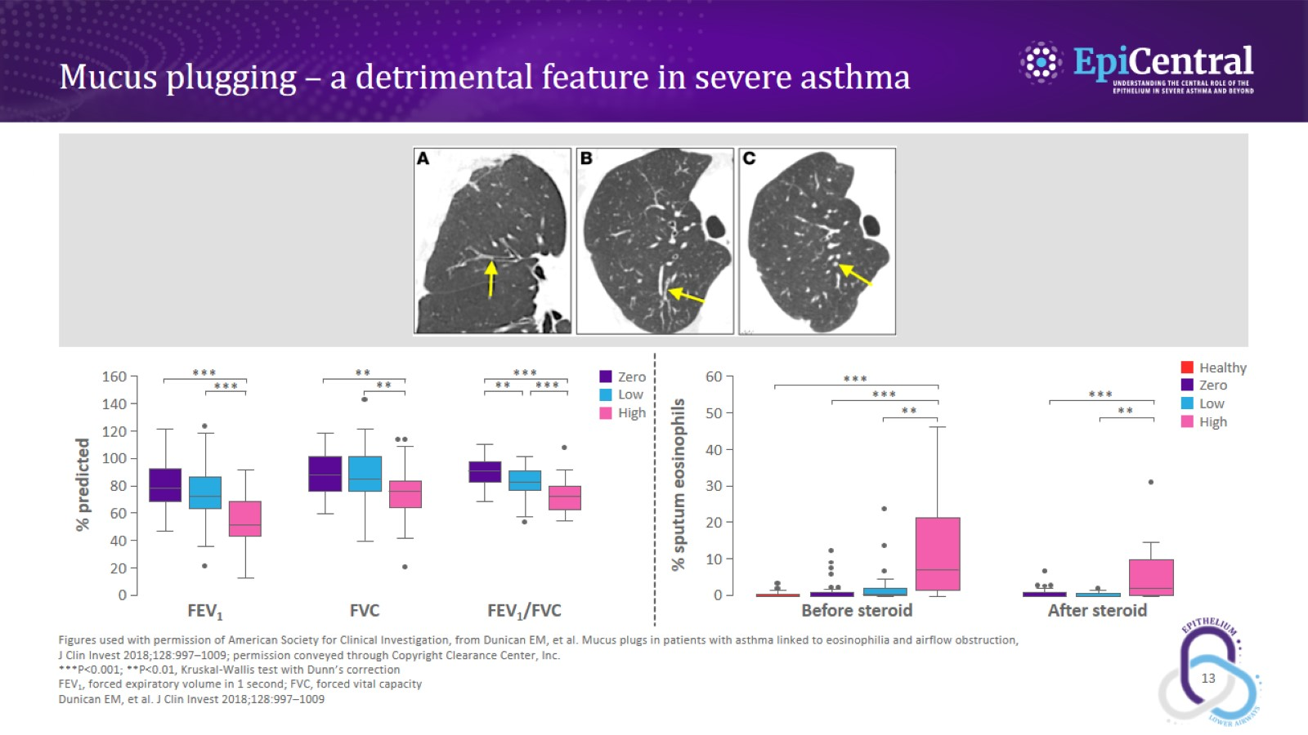
Mucus plugging – a detrimental feature in severe asthma

Slide 14
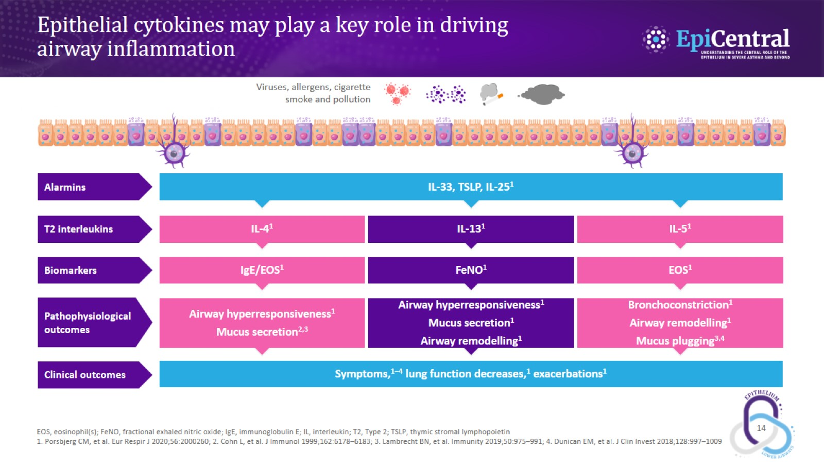
Epithelial cytokines may play a key role in driving airway inflammation

